Slide 1
‘SPARC’ Effective Environmental Evaluation with Fluorescent Gel– Who? Where? How? When?
Clare Rock MD MS, Johns Hopkins University
@ClareRock1

Slide 2
Presenter – Clare Rock
Clare Rock, MD, MS
Assistant Professor of Medicine, Division of Infectious Diseases, Johns Hopkins University School of Medicine
Associate Hospital Epidemiologist, The Johns Hopkins Hospital
Faculty member at Armstrong Institute of Patient Safety and Quality at Johns Hopkins Medicine
Twitter @ClareRock1

Slide 3
Outline
Innovation, change and importance of empathy
Importance of Hospital Hygiene
Monitoring of patient room cleaning
Environmental Evaluation with Fluorescent Gel (EFG)
Starting or improving a program
Data feedback
Notes:
Who are the people who do or should care? Outbreaks
Pathogens are everywhere
Who cares/stakeholders? (stakeholder lens/perspective, goals)

Slide 4
Innovation and Change
Every innovative effort starts with someone expressing how things could be better, someone else validates that concern and offers to help. The nature of teamwork, the core of innovation culture. Without it, we have nothing.
Notes:
When we lose sight of the patient, what is acceptable and not acceptable, we lose the will to make change and remain at substandard status quo
Local guidelines adaptation

Slide 5
It may seem a strange principle to enunciate as the very first requirement in a hospital that it should do the sick no harm.
Florence Nightingale
Notes:
Read more at: https://www.brainyquote.com/authors/florence_nightingale CHECK INNOVATION AND FLORENCE NIGHTINGALE.
FN as an infection preventionist.

Slide 6
Empathy for change & innovation
“ability to understand and share the feelings of another”
Notes:
When we loose site of the patient, what is acceptable and not acceptable, we lose the will to make change and remain at substandard status quo.

Slide 7
Without empathy with patients & others
We may lose motivation (importance of our work)
Clarity on acceptable/not acceptable
We don’t feel indignation
We may stop thinking of infections as mostly preventable
We don’t question how it can be done better because believe it impossible
We lose our willingness to try, innovate and change
Notes:
Without empathy we lose motivation and understanding in the importance of the job we do.

Slide 8
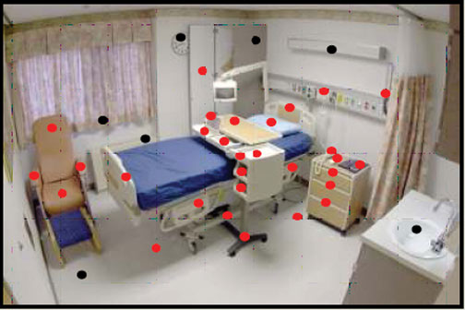
Are “we” focused enough on hospital hygiene?

Slide 9
Infection Prevention
Healthcare workers
Organization / Facility
Government
Stakeholders Hospital Hygiene
Professional societies
Insurance companies
Regulatory
Patients
Internal Facilities / EVC
External cleaning companies
Industry
Notes:
Organization/facility : HCHAPS. vest money in products/staff
Infection prevention: lead decisions regarding products, monitor, teach, audit.
Other HCW:
Government:
Insurance companies
Patients/advocacy.
Industry
Regulatory (TJC)
External cleaning companies: status quo
Facilities/EVC
Professional societies

Slide 10
Betsy

Slide 11
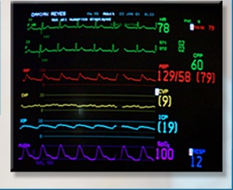
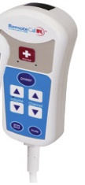
Gets her hospital bed;
Vulnerable;
Relying on healthcare workers to keep her safe
Implicit trust
What is the reality of her hospital environment….
Notes:
With FDA-approved wearable sensors that can continuously monitor all vital signs—including blood pressure, heart rate and rhythm, blood oxygen saturation, respiratory rate, and temperature—there is the potential to preempt a large number of patients being hospitalized in the future.
Linens

Slide 12
Thinks she is getting
But could be getting
Notes:
Breech of trust

Slide 13
Is she at risk?
Organism | Risk | Reference
MRSA | 1.3-1.4 | Data D. Arch Intern Med, 2001 Huang S. Arch Intern Med, 2006
VRE | 1.4
C difficile | 2.35 | Shaughnessy M. ICHE 2011
MDR-PA | 2.3 | Nseir S. Clin Micriobol Infect, 2010
MDR-AB | 4.2
Notes:
A prior room occupant with MDROs. Needs to get past that and move to what can be done. implementation and new devices. Increases Acquisition Risk
Elaine Larson.

Slide 14
Risk may be even higher…
2006-2012, 4 hospitals NYC
761,426 inpatients, matched case control study
multivariable analysis controlling for exposures & patient characteristics
5.83 odds of cases been exposed to prior bed occupant w/ same organism (95% [CI], 3.62–9.39),
4.82 odds of cases having been exposed to a roommate w/ the same organism (95% CI, 3.67–6.34).
Notes:
taphylococcus aureus, Acinetobacter baumannii, Streptococcus pneumoniae, Pseudomonas aeruginosa, Klebsiella pneumoniae, Enterococcus

Slide 16
Which are your patients getting?
Notes:
Breech of trust

Slide 17
Reflection…
Do you know % high touch surfaces in your facility adequately cleaned?

Slide 18
Reflection…
Is feedback given? To whom?
Notes:
for improvement?

Slide 19
Reflection…
Is the feedback appreciated & acted upon?

Slide 20
Monitoring Room Cleaning
Observation
Culturing
Fluorescent gel
ATP system
Notes:
Point out limitations to
Observation – focus on wrong thing – e.g. cleanliness rather than disinifection
Culturing – although able to identify a pathogen, the results are delayed and not useful for immediate feedback. Furth
With ATP system, high readings may indicate viable bacteria or other organism atter including dead bacteria – thus also don’t tell you that the surface is a potential for transmission
ermore, organisims are often identified and it is unclear what information that provides

Slide 21
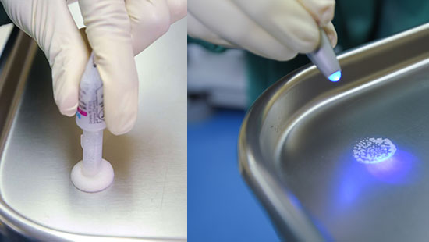
Environmental Evaluation with Fluorescent Gel (EFG)
Feasible, generally low cost
Easy to understand, immediate feedback tool
Notes:
F G – uses invisible transparent getl that dries on surfaces following application. It can be seen then with UV light.
Does not measure cleanliness but thouroughness of cleaning practice i.e. it doesn’t tell you whether bacteria/pathogens are present
With ATP system, high readings may indicate viable bacteria or other organism atter including dead bacteria – thus also don’t tell you that the surface is a potential for transmission.

Slide 22
Step 1 EFG

Slide 23
Step 2 EFG

Slide 24
Step 3 EFG

Slide 25
Step 4 EFG

Slide 26
Starting or improving EFG program
Pilot with “low hanging fruit” unit likely to succeed
ICU with opportunity to improve and supportive environment
Stepped approach to iron out kinks before more units
Clarify purpose and expectation in supportive environment
Include EVC associates, supervisors, others
Feedback mechanisms
who, how, when, why
Clear action plan including rewards, retraining
Consider patient role
Notes:
EVC associates, Infection Control committee, hospital leadership etc.

Slide 27
Starting or improving EFG program
Healthcare worker best suited for EFG team
How many rooms, high touch surfaces?
How to pick rooms, high touch surfaces?
Daily, discharge cleaning or both?

Slide 28
Implementing EFG program – which HCW?
Healthcare worker Type | Advantages | Disadvantages
Infection Control Practitioner | -Objective -Vested -Understands the overall mission -usually experience in giving constructive feedback | -Resource intensive
Unit Nurse | -Can strengthen EVC-nursing collaboration and joint ownership of patient care -Understanding of HTS that are nurse responsibility and EVC responsibility -Data can be discussed at unit quality meetings -Prompts discussion on the unit -All shifts can be monitored | -Need to ensure feedback is constructive, and non-blaming -Multiple competing nursing priorities -May need to train multiple nurses on each unit
EVC Supervisor | -EVC associate are accountable to supervisor -Feedback can identify systemic problems that can be addressed | -May not be objective -Data may not get communicated to unit -Resource intensive
Notes:
Not that many dots. Who can do the dotting?? People. Split into 2. Move to where start working on nurses.

Slide 29
Implementing EFG program- Who?
Healthcare worker Type | Advantages | Disadvantages
EVC Associate | -Take ownership over jobs and performance improvements. -Can identify problems related to cleaning certain HTS that can lead to improved processes. -All shifts can be monitored | -Peer to peer monitoring and feedback is challenging to give and receive. -Objectivity may be compromised
“Secret Shopper” | -May reduce Hawthorne Effect | -Validity may be compromised if not trained correctly; need significant oversight -Inefficient if there is a lot of turnover and frequent training needs
Mixed role: Nurse and EVC associate | -Daily room cleaning is responsibility of both nursing (e.g. IV pole, mechanical ventilators) and EVC. -Joint accountability -Direct data feedback goes to both nursing (from EVC associate) and EVC (from nurse). | -Lack of ownership -Need to ensure feedback is in a respectful manner (modeling of constructive feedback discussions by infection control may help).
Notes:
Not that many dots. Who can do the dotting?? People. Split into 2. Move to where start working on nurses.

Slide 30
Patient Room Cleaning Evaluation with Fluorescent Gel (FG):
Optimal number of High Touch Surfaces and Patient Rooms?
Removal of FG from pre-marked high touch surfaces assesses quality of room cleaning
This drives improvement
2. Perceived time and resource need for gel marking may limit uptake strategy
But how much time is really needed?
3. We determined the least number of rooms and high touch surfaces to mark with gel to reflect cleaning
1 academic hospital
3,000 FG in 228 random rooms on 13 units.
Optimal in academic hospital=
3 randomly selected high touch surface from 2 randomly selected rooms
Remains optimal when good (>80%) and poor (< 80%) gel removal, and for both discharge and daily cleaning
Good news! Let’s go!
Implementing FG program is not resource intensive.
6 Sampling Strategies
1 HTS per room?
2 HTS per room?
3 HTS per room?
4 HTS per room?
5 HTS per room?
1 HTS in main room,
plus 1 in bathroom?
Minimum number?
Rock C (@ClareRock1), Haft M, Small B, Hsu Y, Gurses A, Xie A, Scheeler V, Cummings S, Trexler P, Milstone A, Maragakis L, Cosgrove S, for the CDC Prevention Epicenters.
Visual Abstract Representation of: Evaluating the Accuracy of Sampling Strategies for Fluorescent Gel Monitoring of Patient Room Cleaning. Infect Control Hosp Epidemiol.in press.
This Visual Abstract was created by Mark Haft
@ClareRock1
Notes:
Evaluation with Fluorescent Gel. How much is enough? Less than you think! 3 high touch surfaces in 2 rooms = 1 clean unit. Good news! Let’s go! @ClareRock1 et al.

Slide 31
How to pick rooms and high touch surfaces
Systematic way to pick rooms & HTS important
Ensures representation of:
Contact precaution and non-CP rooms
Room where patient/family present
Different rooms
Minimizes risk of EVC associate knowing where FG placed
More objective, valid data, representative of overall thoroughness of cleaning
Notes:
Every room has equal chance of selection

Slide 32
Randomize room selection
https://www.randomizer.org/tutorial/

Slide 33
Randomize High Touch Surface selection

Slide 34
Discharge, daily or both
EFG of three HTS reflects both daily and discharge thoroughness of cleaning
Recommend not differentiating between daily and discharge when selecting rooms

Slide 35
Both Discharge and daily cleaning
Discharge cleaning only EFG
Many existing programs check discharge cleaning only
Challenging & may be inefficient
smaller number of rooms available to check
FG placement where patient planned for discharge requires coordination
EFG team may be unaware of rapid discharges
If unplanned or discharge outside regular hours, EFG team may not be available
Hawthorne effect (EVC associate awareness) is more likely when placing between patient discharge & cleaning
May be unfeasible due to pressure for timely room turnover

Slide 36
Both Discharge and daily cleaning
Daily & discharge cleaning EFG.
All hospital rooms eligible for checking.
Increase efficiency as no coordination or waiting for specific rooms.
EFG can occur during regular working hours and any time during patient stay.
Improvement in daily cleaning is important for prevention of pathogen transmission. Ineffective daily cleaning causes discharge cleaning to be more challenging.

Slide 37
Effective Data Feedback
EVC associate
EVC supervisor
Hospital unit
Hospital wide committees and executives

Slide 38
Effective Data Feedback – EVC associate
Individual feedback may be difficult to give and receive
Empathetic, curious approach works well
Immediate in person feedback identifies systematic barriers for cleaning of certain HTS
Encourage EVC associate and supervisor to check
Recognize strong performers
Supportive improvement accountability plan

Slide 39
Effective Data Feedback – EVC supervisor
Include EVC supervisors and associates in data feedback
Email real time data to EVC manager, allows for early intervention
Notes:
Merit uniform T-shirt for best performers e.g. "100% Club" for perfect FG removal scores.
meal vouchers, pizza party
hospital-wide recognition (digital displays & newsletters)
certificates of appreciation

Slide 40
Effective Data Feedback – Hospital Unit
Disseminate at unit QI meetings
Discuss collaborative performance improvement plan
Invite and encourage EVC associate attendance

Slide 41
Effective Data Feedback – Hospital committees and executives
Notes:
May want to link also with c diff or other HAI outcomes.

Slide 42
Outline
Innovation, change and importance of empathy
Importance of Hospital Hygiene
Monitoring of patient room cleaning
Environmental Evaluation with Fluorescent Gel (EFG)
Starting or improving a program
Data feedback
Notes:
Who are the people who do or should care? Outbreaks
Pathogens are everywhere
Who cares/stakeholders? (stakeholder lens/perspective, goals)

Slide 43
Thank you
Questions or comments?

